Slide 1


SHEMSU DABESA GANE
OCTOBER 2022

Slide 2

Outline
Executive Summary
Introduction
Methodology
Results
Conclusion

Slide 3
Executive Summary
Summary of methodologies
Collecting the Data with an API: Gathering SpaceX launch data by using the SpaceX REST API
Data Collection with Web Scraping
Data Wrangling
Exploratory Analysis Using SQL and Data visualization
Interactive Visual Analytics/Map with Folium
Interactive Dashboard Using Plotly Dash
Predictive Analysis (For each classification model)
Summary of all results
Exploratory Data Analysis(EDA) result
Predictive Analytics result from Machine Learning Lab
Interactive analytics in screenshots

Slide 4
Introduction
Project background and context
The commercial space age is here, companies are making space travel affordable for everyone. Virgin Galactic is providing suborbital spaceflights. Rocket Lab is a small satellite provider. Blue Origin manufactures sub-orbital and orbital reusable rockets. Perhaps the most successful is SpaceX. SpaceX advertises Falcon 9 rocket launches on its website with a cost of 62 million dollars; other providers cost upwards of 165 million dollars each, much of the savings is because SpaceX can reuse the first stage. Therefore, if we can determine if the first stage will land, we can determine the cost of a launch. Stage two, or the second stage, helps bring the payload to orbit, but most of the work is done by the first stage. The first stage does most of the work and is much larger than the second stage. This stage is quite large and expensive. Unlike other rocket providers, SpaceX's Falcon 9 Can recover the first stage. Sometimes the first stage does not land. Sometimes it will crash . Other times, Space X will sacrifice the first stage due to the mission parameters like payload, orbit, and customer. The goal of the project is to create a machine learning pipeline to predict if the first stage will land successfully.
Problems you want to find answers
What factors determine if the rocket will land successfully?
The interaction amongst various features that determine the success rate of a successful landing.
What operating conditions needed to increase the probability of successful landing/the best result

Slide 5

Section 1

Slide 6
Methodology
Executive Summary
Data collection methodology:
Data was collected by using SpaceX REST API and web scrapping from Wikipedia using Python BeautifulSoup package
Perform data wrangling
One-hot encoding was applied to categorical features, Sampling Data(to remove/filter unnecessary features),Dealing with Nulls
Perform exploratory data analysis (EDA) using visualization and SQL
Perform interactive visual analytics using Folium and Plotly Dash
Perform predictive analysis using classification models
How to build, tune, evaluate classification models

Slide 7
Data Collection
Describe how data sets were collected.
As mentioned in the methodology section, the dataset was collected by using get request to the SpaceX REST API and web scrapping from Wikipedia
Next, we decoded the response content as a Json using .json() function call and turn it into a pandas dataframe using .json_normalize().
Then we Filter the dataframe to only include Falcon 9 launches by removing data related to the Falcon 1 launches
Then we deal with Missing Values: We calculate the mean of the PayloadMass data and then replace the null values in PayloadMass with the mean to clean the data.
In addition, we performed web scraping from Wikipedia for Falcon 9 launch records with BeautifulSoup
The objective was to extract the launch records as HTML table, parse the table and convert it to a pandas dataframe for future analysis.
Finally we export the data to a CSV for future use.

Slide 8
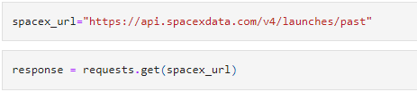
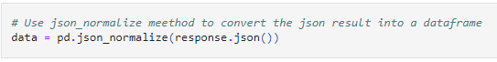
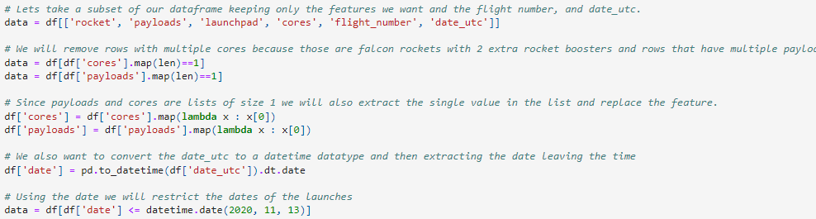
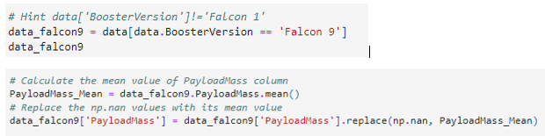
Data Collection – SpaceX API
The dataset was collected by using get request to the SpaceX REST API
We Use json_normalize method to convert json result to dataframe
Performed data cleaning(feature selection, filtering, conversion) and filling the missing value
GitHub URL :
https://github.com/shemsud1/Applied-Data-Science-Capstone/blob/main/jupyter-labs-spacex-data-collection-api%20.ipynb

Slide 9
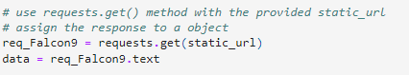
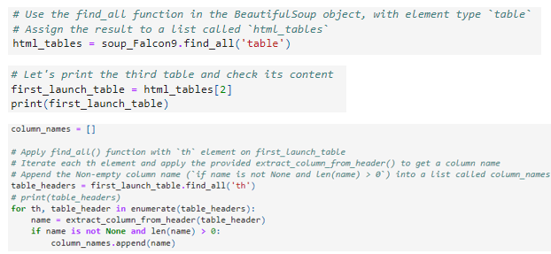
Data Collection - Scraping
Request the Falcon9 Launch Wiki page from its URL
Create a BeautifulSoup object from the HTML response
Extract all column names from the HTML table header and
Create a data frame by parsing the launch HTML tables
GitHub URL:
https://github.com/shemsud1/Applied-Data-Science-Capstone/blob/main/jupyter-labs-webscraping.ipynb

Slide 10
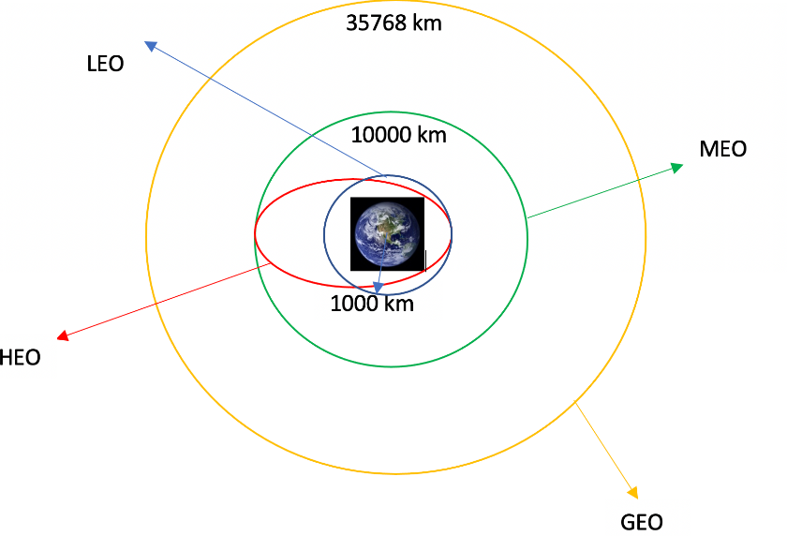
Data Wrangling
Perform some EDA) to find some patterns in the data and determine what would be the label for training supervised models
Calculate the number of launches on each site
Calculate the number and occurrence of each orbit
Calculate the number and occurrence of mission outcome per orbit type
Create a landing outcome label from Outcome column & export the result to csv
GitHub URL:
https://github.com/shemsud1/Applied-Data-Science-Capstone/blob/main/labs-jupyter-spacex-Data%20wrangling.ipynb

Slide 11
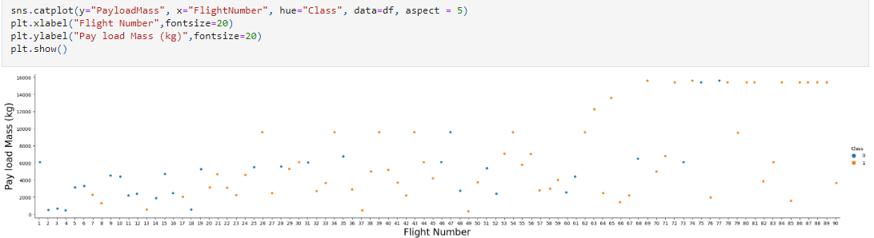
EDA with Data Visualization
We first started by using scatter plot to find the relationship between the variables such as between:
PayloadMass and Flight Number.
Flight Number and Launch Site.
PayloadMass and Launch Site.
Flight Number and Orbit Type.
PayloadMass and Orbit Type.
GitHub URL:
https://github.com/shemsud1/Applied-Data-Science-Capstone/blob/main/jupyter-labs-eda-dataviz.ipynb
Scatter plots show dependency of attributes on each other. Once a pattern is determined from the graphs. It’s very easy to see which factors affecting the most to the success of the landing outcomes.
We see that as the flight number increases, the first stage is more likely to land successfully. The payload mass is also important; it seems the more massive the payload, the less likely the first stage will return.

Slide 12
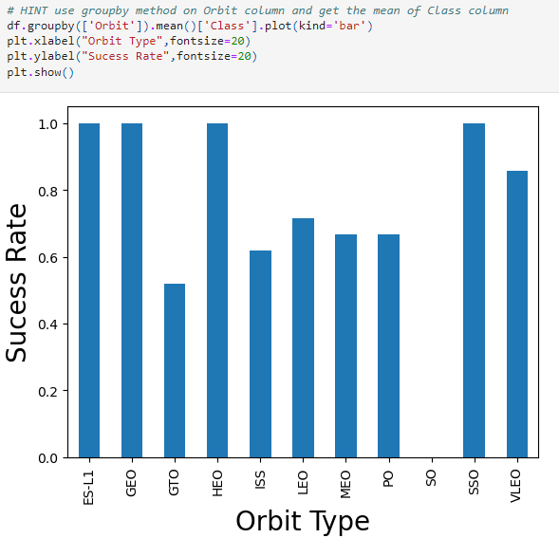
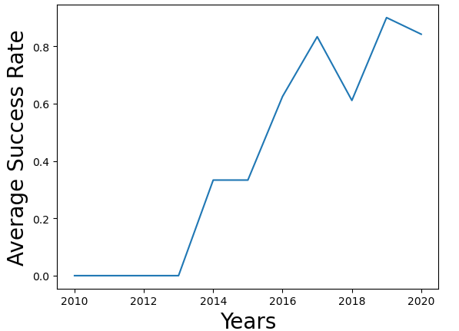
EDA with Data Visualization(Cont..)
To Visualize the relationship between success rate of each orbit type, we created Bar Chart. From this bar graph we can easily determine which orbits have the highest probability of success.
To visualize and get the average launch success yearly trend, we created/plotted a line chart.
We can observe that the success rate since 2013 kept increasing till 2020.
We then use Feature Engineering to select the features that will be used in success prediction in the future module. We create the dummy variables to categorical columns.
GitHub URL:
https://github.com/shemsud1/Applied-Data-Science-Capstone/blob/main/jupyter-labs-eda-dataviz.ipynb

Slide 13
EDA with SQL
Using SQL, we had performed many queries to get better understanding of the Spacex DataSet:
We Load the dataset into the corresponding table in a Db2 database & execute SQL queries against the database. For instance:
Display the names of the unique launch sites in the space mission
Display the total payload mass carried by boosters launched by NASA (CRS)
Display average payload mass carried by booster version F9 v1.1
List the names of the boosters which have success in drone ship and have payload mass greater than 4000 but less than 6000
List the total number of successful and failure mission outcomes
List the names of the booster_versions which have carried the maximum payload mass. Use a subquery
List the records which will display the month names, failure landing_outcomes in drone ship ,booster versions, launch_site for the months in year 2015.
Rank the count of successful landing_outcomes between the date 04-06-2010 and 20-03-2017 in descending order.
GitHub URL: https://github.com/shemsud1/Applied-Data-Science-Capstone/blob/main/jupyter-labs-eda-sql-coursera_sqllite.ipynb

Slide 14
Build an Interactive Map with Folium
To visualize the launch data into an interactive map, we marked all launch sites, and added map objects such as markers, circles, lines to mark the success or failure of launches for each site on the folium map.
We assigned the feature launch outcomes (failure or success) to class 0 and 1.i.e., 0 for failure, and 1 for success.
Using the color-labeled marker clusters(Red for 0 & Green for 1, we identified which launch sites have relatively high success rate.
We then calculated the distances between a launch site to its proximities. We answered some questions. For instance:
Are launch sites in close proximity to railways, highways and coastlines?
Do launch sites keep certain distance away from cities?
GitHub URL: https://github.com/shemsud1/Applied-Data-Science-Capstone/blob/main/lab_jupyter_launch_site_location.ipynb

Slide 15
Build a Dashboard with Plotly Dash
We built an interactive dashboard with Plotly dash which allows users to input data as needed.
We Add a dropdown list to enable Launch Site selection
We plotted pie charts to show the total successful launches count for all sites
We Add a slider to select payload range. We then plotted scatter graph showing the relationship with Outcome and Payload Mass (Kg) for the different booster version.
GitHub URL:
https://github.com/shemsud1/Applied-Data-Science-Capstone/blob/main/spacex_dash_app.py

Slide 16
Predictive Analysis (Classification)
We loaded the data using numpy and pandas, transformed the data, split our data into training and testing.
We built different machine learning models and tune different hyperparameters using GridSearchCV.
We used accuracy as the metric for our model, improved the model using feature engineering and algorithm tuning. We plotted the confusion matrix.
We found the best performing classification model. The model with the best accuracy score will be the best performing model.
GitHub URL:
https://github.com/shemsud1/Applied-Data-Science-Capstone/blob/main/SpaceX_Machine%20Learning%20Prediction_Part_5.ipynb

Slide 17
Results
The results will be categorized to 3 main results which is:
Exploratory data analysis results
Interactive analytics demo in screenshots
Predictive analysis results

Slide 18

Section 2

Slide 19
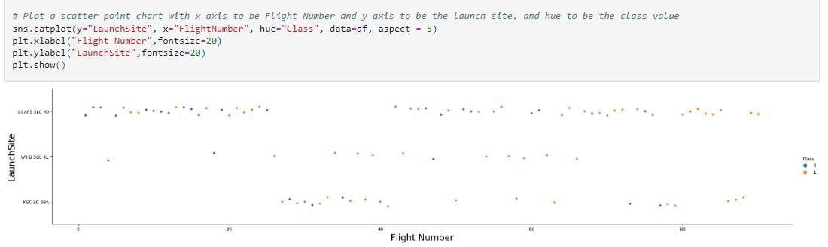
Flight Number vs. Launch Site
This scatter plot shows that the larger the flights amount of the launch site, the greater the success rate will be.

Slide 20
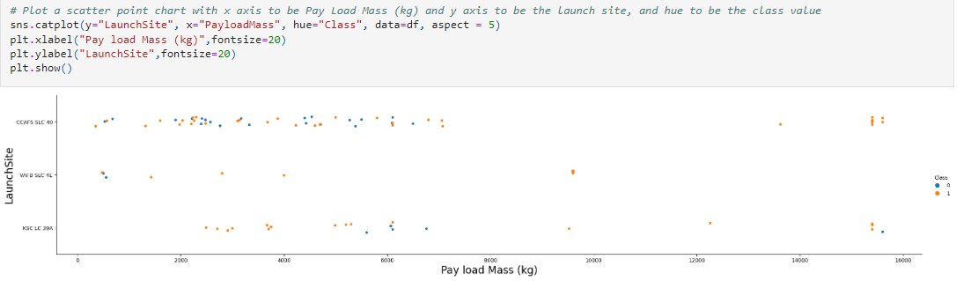
Payload vs. Launch Site
This scatter plot shows, the greater the payload mass for the launch site CCAFS SLC 40, the higher the success rate for the rocket.
The greater the payload mass (greater than 7000 Kg), the higher the success rate for the rocket. But there is no clear pattern to take a decision, if the launch site is dependent on Payload Mass for a success launch.
For the VAFB-SLC launch site there are no rockets launched for heavy-payload mass(greater than 10000).

Slide 21
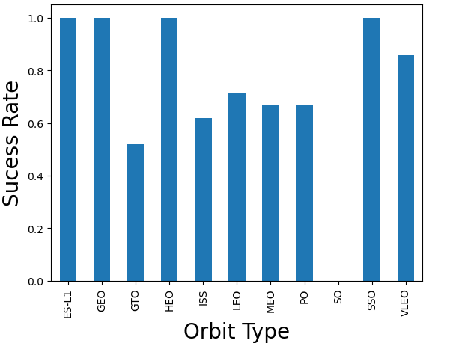
Success Rate vs. Orbit Type
From this bar chart , we can see that ES-L1, GEO, HEO, SSO, VLEO had the most success rate while SO orbit produced 0% rate of success.

Slide 22
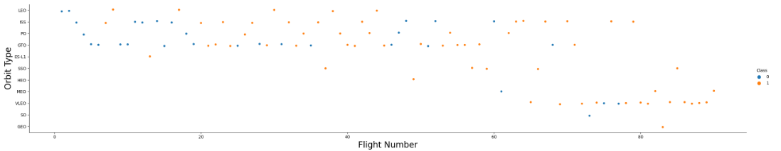
Flight Number vs. Orbit Type
We observe that for the LEO orbit, the success is related to the number of flights (i.e. success increases with the number of flights)
On the other hand, it seems there is no relationship between flight number and the GTO orbit.

Slide 23
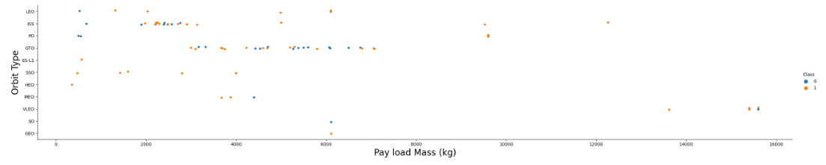
We can observe that with heavy payloads the successful landing or positive landing rate are more for Polar, LEO and ISS.
We can also observe that heavy payloads have a negative influence on MEO and VLEO orbits.
However for GTO we cannot distinguish this well as both positive landing rate and negative landing(unsuccessful mission) are both there here.
Payload vs. Orbit Type

Slide 24
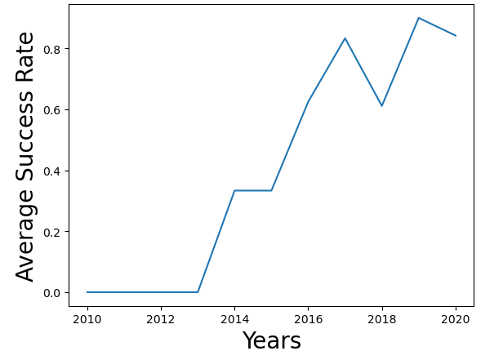
Launch Success Yearly Trend
We can observe that the success rate since 2013 kept increasing till 2020.

Slide 25
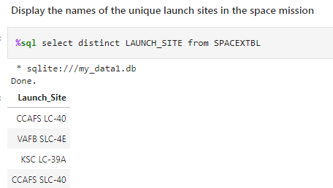
All Launch Site Names
Explanation:
We used the key word DISTINCT to show only unique launch sites from the SpaceX data.

Slide 26
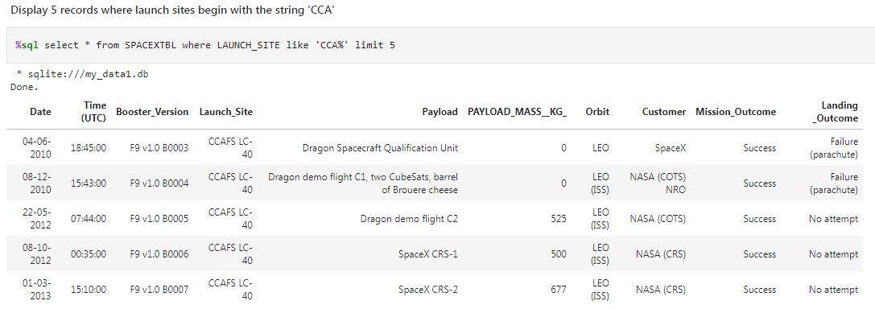
Explanation:
We used the key word 'LIMIT 5' in the query to fetch 5 records from the table SPACEX and with condition LIKE keyword and wildcard 'CCA%'. The percentage at the end suggests that the launch_site name must start with CCA characters.
Launch Site Names Begin with 'CCA'

Slide 27
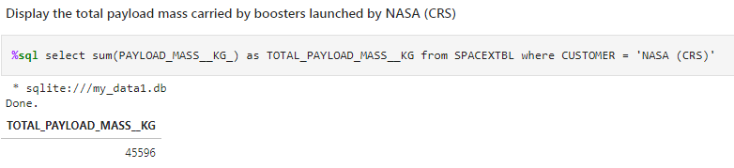
Total Payload Mass
Explanation:
We calculated the total payload carried by boosters from NASA as 45596. Using the function SUM() to calculate the total in the column PAYLOAD_MASS__KG_ and the WHERE clause filters the data to fetch Customer's by name "NASA (CRS)".

Slide 28
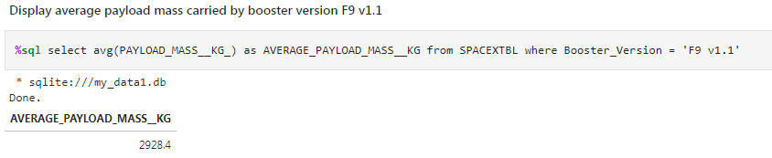
Explanation:
We calculated the average payload mass carried by booster version F9 v1.1 as 2928.4. Using the function AVG() to calculate the average in the column PAYLOAD_MASS__KG_ and the WHERE clause filters the dataset to only perform calculations on Booster version F9 v1.1.
Average Payload Mass by F9 v1.1

Slide 29
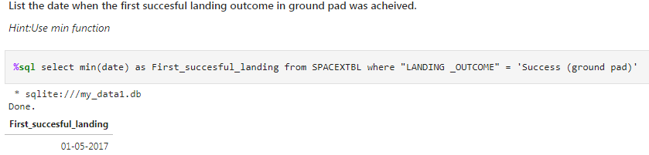
First Successful Ground Landing Date
Explanation:
We used the min() function to find the result. We observed that the dates of the first successful landing outcome on ground pad was 5th January 2017

Slide 30
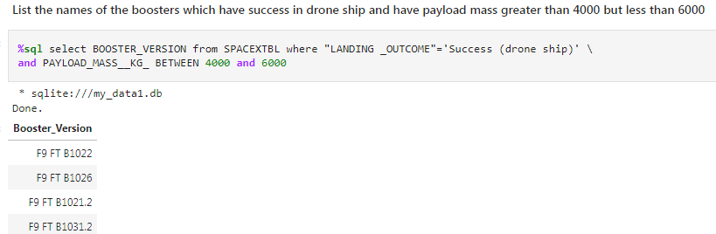
Explanation: We used the WHERE clause to filter for boosters which have successfully landed on drone ship and applied the AND condition to determine successful landing with payload mass greater than 4000 but less than 6000
Successful Drone Ship Landing with Payload between 4000 and 6000

Slide 31
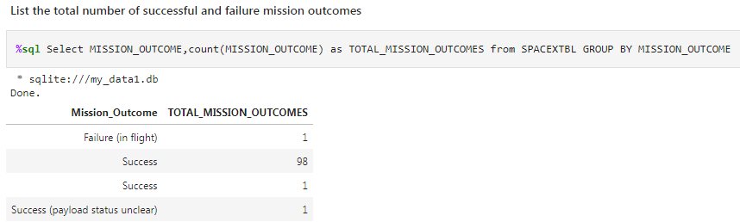
Explanation: We used count() function on Mission_Outcome column and group them on the same column to get a success or a failure total counter.
Total Number of Successful and Failure Mission Outcomes

Slide 32
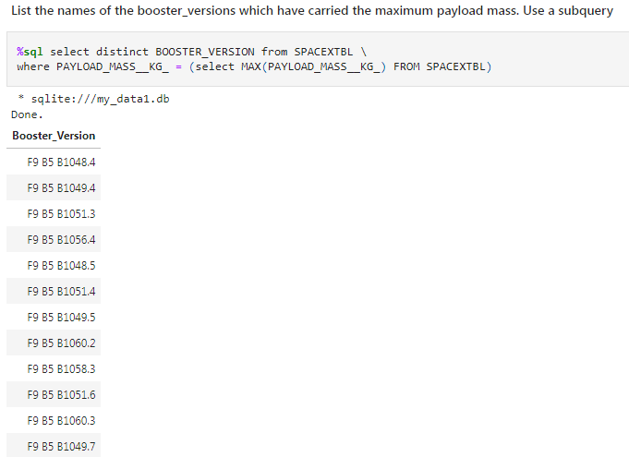
Explanation: We used the MAX() function to work out the maximum payload in the column PAYLOAD_MASS__KG_ in the sub query. The WHERE clause filters the Booster Version which had that maximum payload.
Boosters Carried Maximum Payload

Slide 33
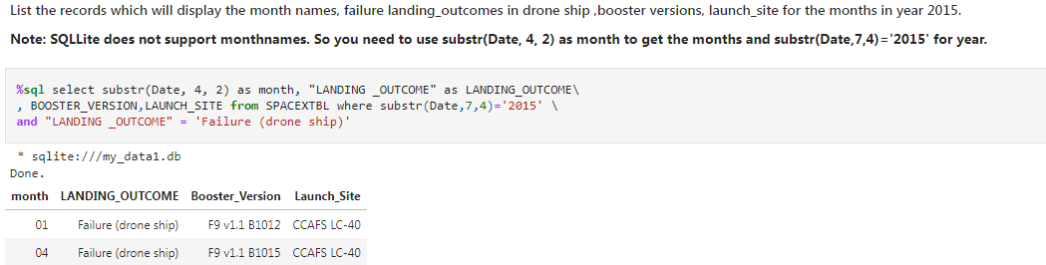
Explanation:
We need to list the records which will display the name of the Month, failure landing_outcomes in drone ship, booster versions, launch_site for months in the year 2015. We also used substr() function to extract months and year from the Date column.
2015 Launch Records

Slide 34
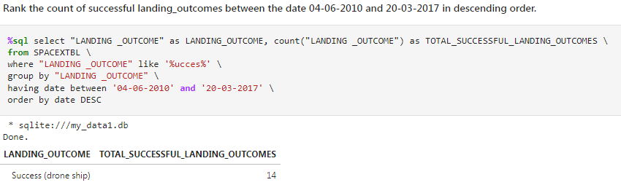
We selected Landing outcomes and the COUNT of landing outcomes from the data and used the WHERE clause
and like '%ucces%' wildcard to filter for successful landing outcomes . We applied the GROUP BY clause to group the landing outcomes and the having clause to filter date between '04-06-2010' and '20-03-2017' . Finally, we applied the ORDER BY clause to order the grouped landing outcome in descending order.
Rank Landing Outcomes Between 2010-06-04 and 2017-03-20

Slide 35

Section 3

Slide 36
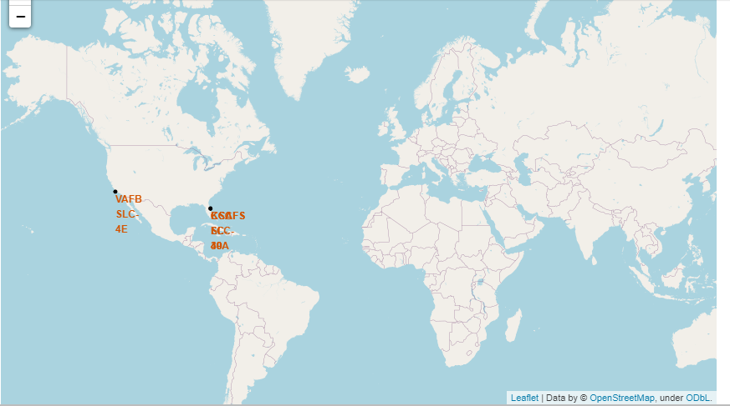
All launch sites’ location markers on a global map
We can see that all the SpaceX launch sites are located inside the United States California and Florida Regions

Slide 37
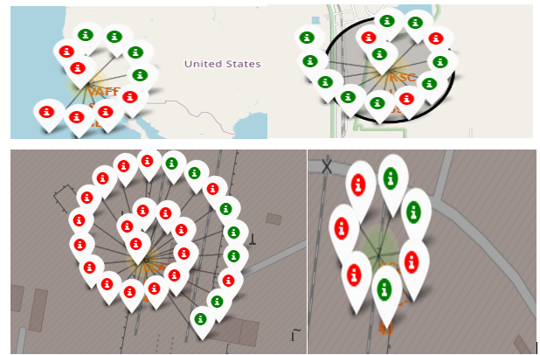
Markers showing launch sites with color labels
Green Marker shows successful launches and Red Marker shows failures launches

Slide 38
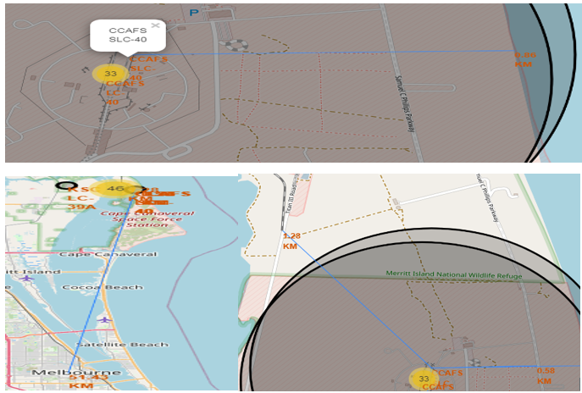
Launch Sites Distance to Landmarks
The distance calculated was as follows:
distance_highway = 0.5834695366934144 km
distance_railroad = 1.2845344718142522 km
distance_city = 51.43416999517233 km

Slide 39

Section 4

Slide 40
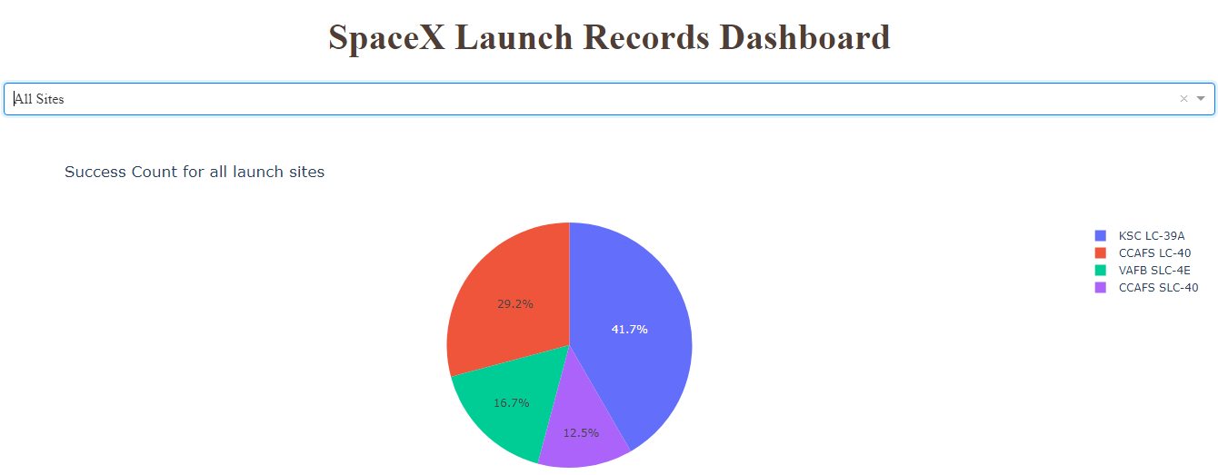
We can see that KSC LC-39A had the most successful launches from all the sites.
Launch success count for all sites

Slide 41
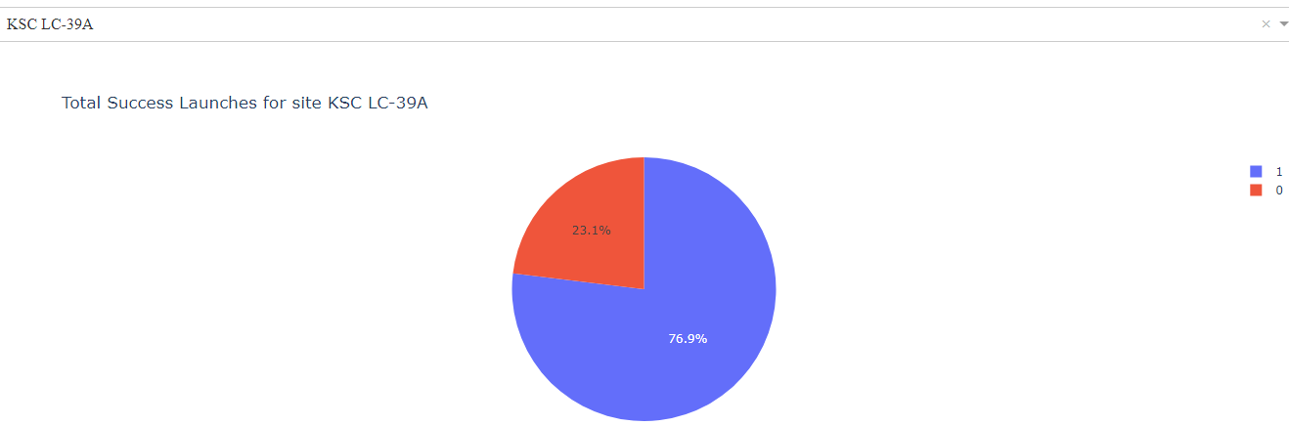
KSC LC-39A achieved a 76.9% success rate while getting a 23.1% failure rate.
Launch site with highest launch success ratio

Slide 42
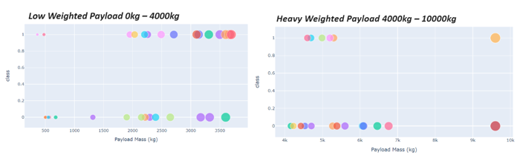
We can see the success rates for low weighted payloads is higher than the heavy weighted payloads
Payload vs. Launch Outcome scatter plot for all sites, with different payload selected in the range slider

Slide 43

Section 5

Slide 44
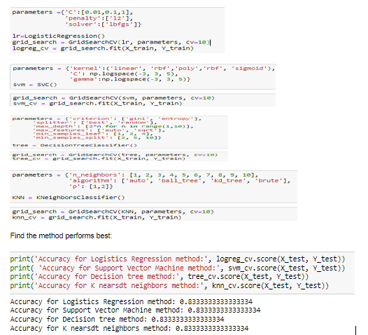
Classification Accuracy
As we can see below, it seems that ALL the algorithms have equal accuracy

Slide 45
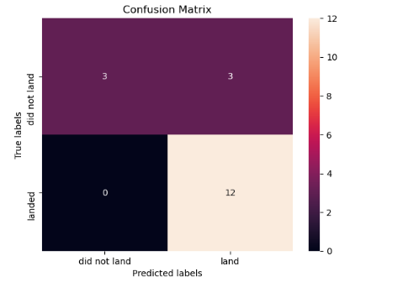
Confusion Matrix
Examining the confusion matrix, we see that logistic regression can distinguish between the different classes. We see that the major problem is false positives.

Slide 46
Conclusions
We can conclude that:
Orbits ES-L1, GEO, HEO, SSO, VLEO had the most success rate while SO orbit produced 0% rate of success.
The larger the flight amount at a launch site, the greater the success rate at a launch site.
Launch success rate started to increase in 2013 till 2020. We can say that success rates for SpaceX launches has been increasing relatively with time and it looks soon they will reach the required target.
KSC LC-39A had the most successful launches of any sites.

Slide 47


